Slide 1
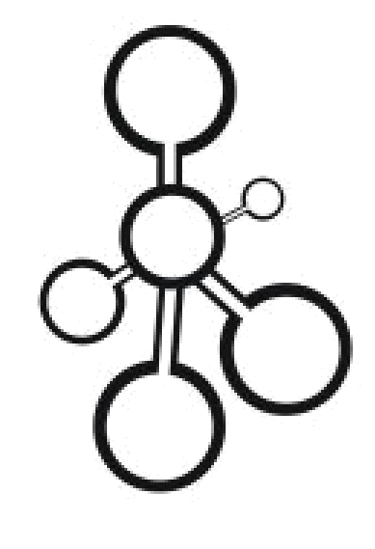
Data Structures
Lecture 7: Queues

Slide 2


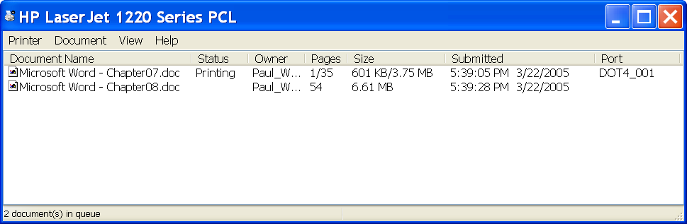
Queues
Queues are abstract data structures (ADT) that are based on the FIFO principle (First-In-First-Out)
Applications:
- Print Queue
- Waiting list
Print Stack?
Notes:
Why stacks?

Slide 3
Queue Functions
Function
bool empty() const
Item_Type& front(); const Item_Type& front() const
void pop()
void push(const Item_Type& item)
size_t size() const

Slide 4
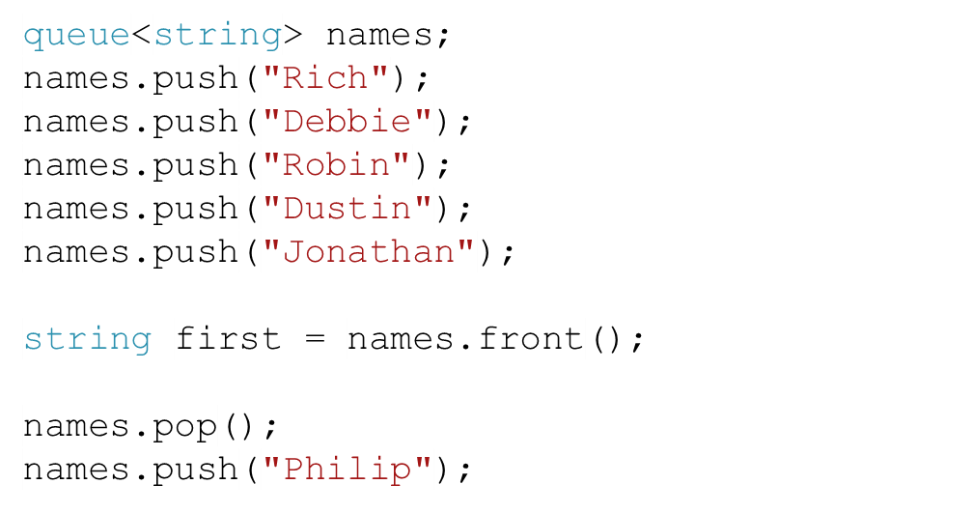
Queue Example
front
Rich
rear
front
Debbie
rear
rear
Robin
rear
Dustin
rear
Jonathan
rear
Philip

Slide 5

Task
Not in the book
Write a program that models checkout lines at a supermarket, using the Queue class.
You will need to determine how the customer will decide which line (queue) to join. The time the cashiers need to process each customer depends on the number of items the customer bought, and how fast the checker is(on average how long in seconds for one item). Once checked out, the customer is removed from the line.
Draw a UML diagram that represents your solution
Perhaps work in groups if you like.

Slide 6
Solution
Not in the book
Line
total_items: int
speed_rate: int
+ push(num_items: int): void
+pop(): void
Vector<Line>
10
1
Queue<int>
customers
1
lines
SuperMarket
+ joinCustomer(int)

Slide 7
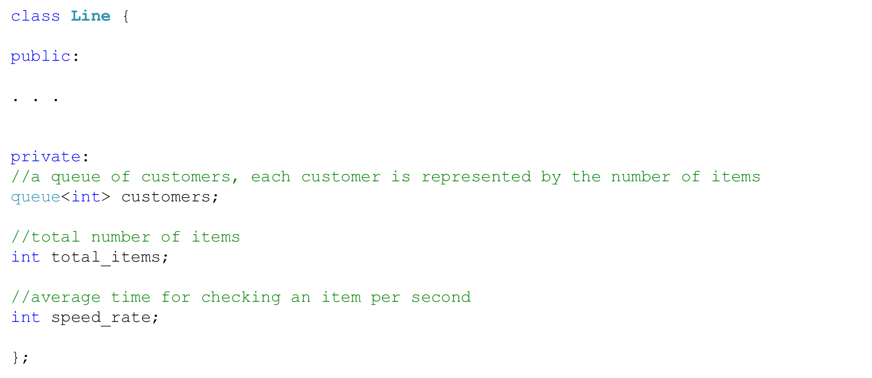
The Line Class
Not in the book

Slide 8
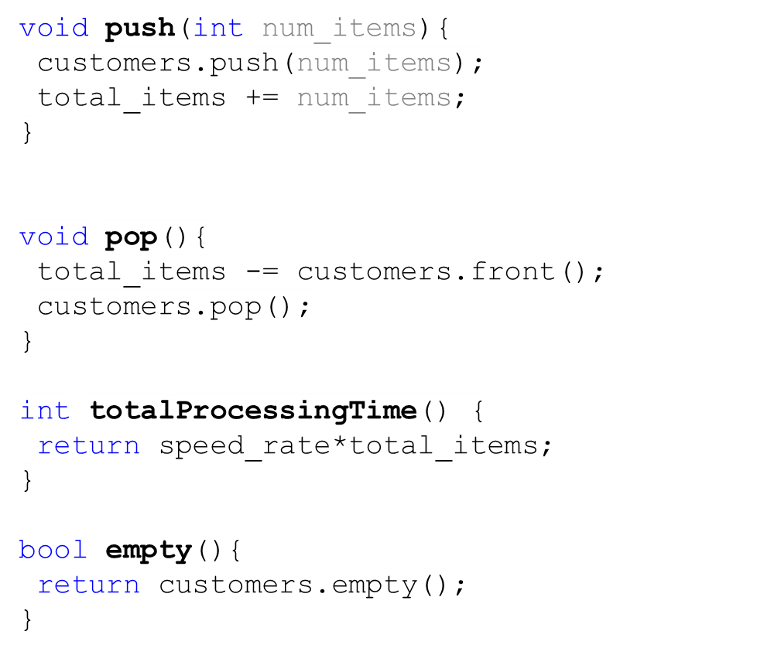
The Line Member Functions
Not in the book

Slide 9
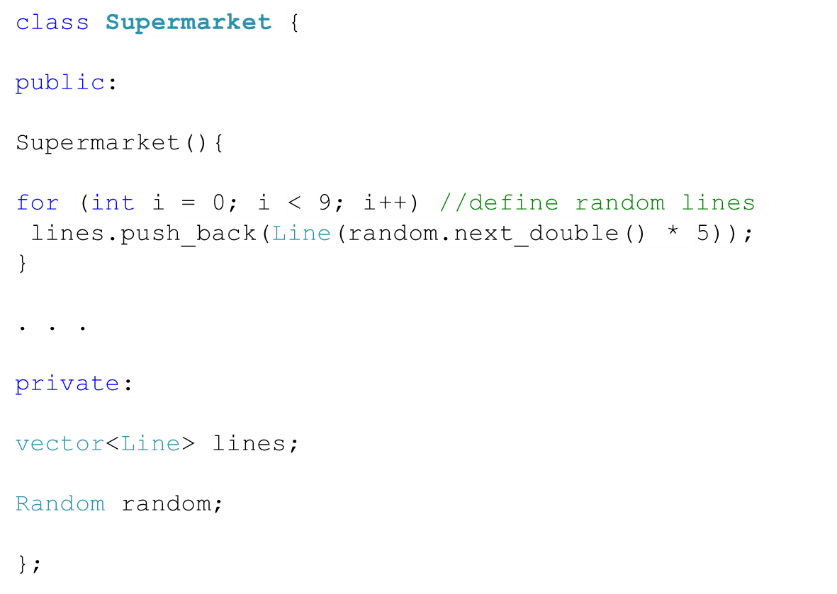
The Supermarket Class
Not in the book

Slide 10
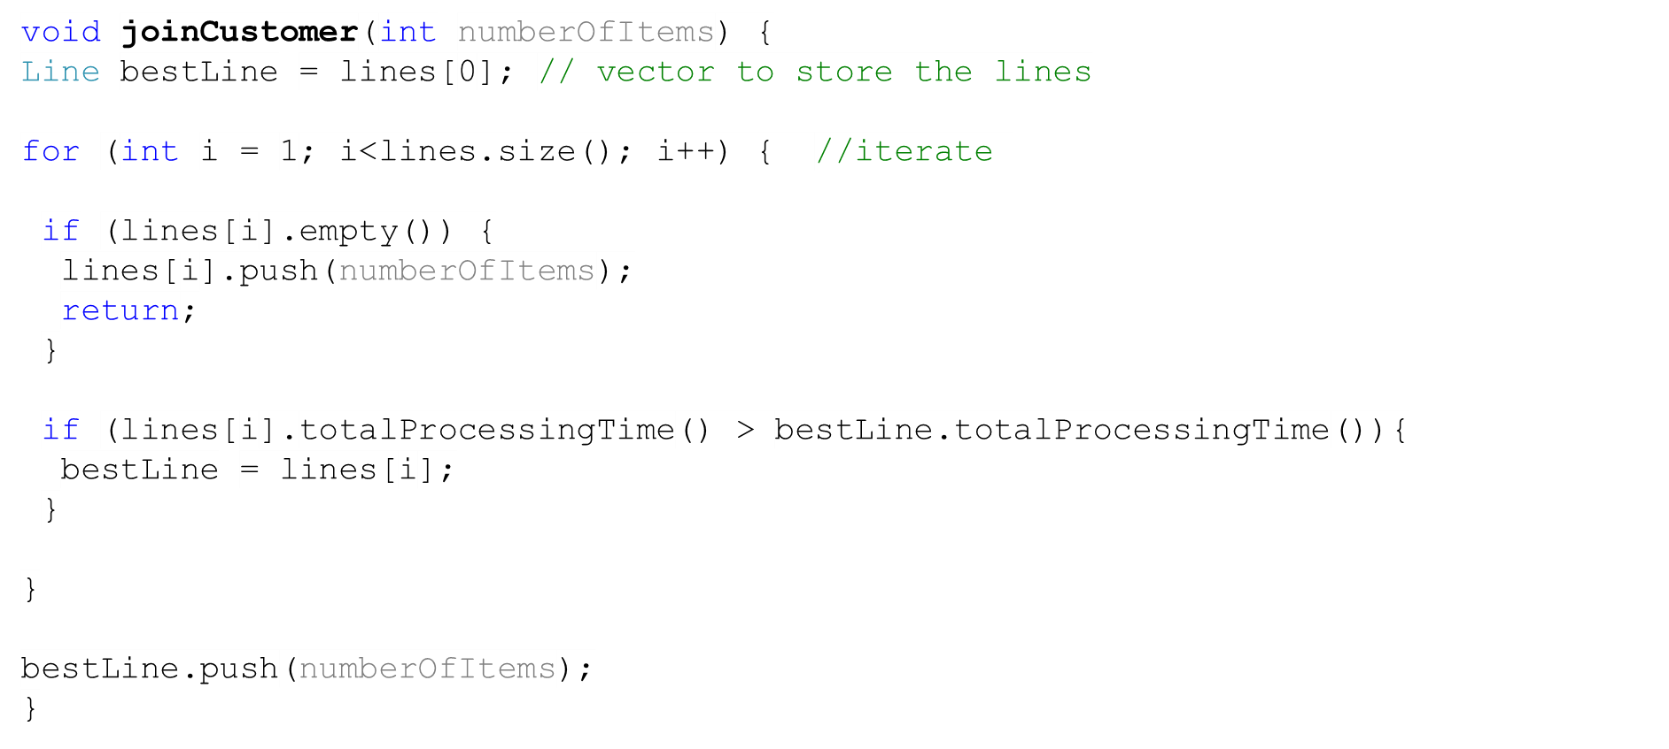
The Supermarket Functions
Not in the book

Slide 11

Discussion (1)
Not in the book
Which approach is better? Single queue or multiple queues?
Single Queue
Multiple Queues
Servers
Servers
Reference: www.math.wm.edu/~rrkinc/queue_intro.ppt

Slide 12
Discussion (2)
Not in the book
Advantages of Single Queue
Advantages of Multiple Queues
1. Guarantees fairness
(FIFO applied to all arrivals)
1. The service provided can be differentiated (e.g. supermarket express lanes)
2. No customer anxiety over choice of queue
2. Customer has more flexibility
3. The most efficient set up for minimizing time in the queue
3. Balking behavior may be deterred
4. Line switching is avoided
Reference: www.math.wm.edu/~rrkinc/queue_intro.ppt

Slide 13
Task
Not in the book
We have available to us a queue, and we want to remove an item that can be anywhere in the queue. However, we want to make sure the queue goes back to its old state. For instance, removing “C” in the queue on the left will result in the queue on the right.
You are only allowed to use the queue functions (push, pop, size).
front
A
B
front
A
C
B
back
D
back
D

Slide 14
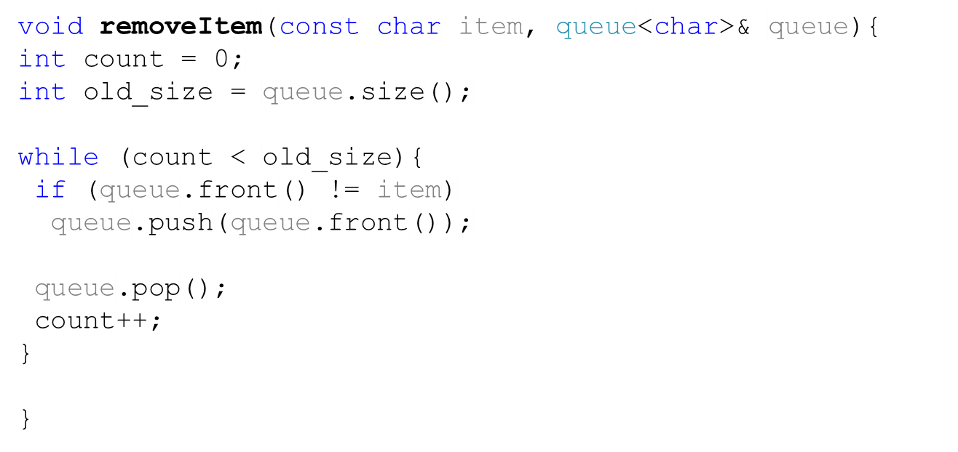
Task
Not in the book
front
A
front
B
front
C
front
D
back
front
A
back
back
B
back
D

Slide 15
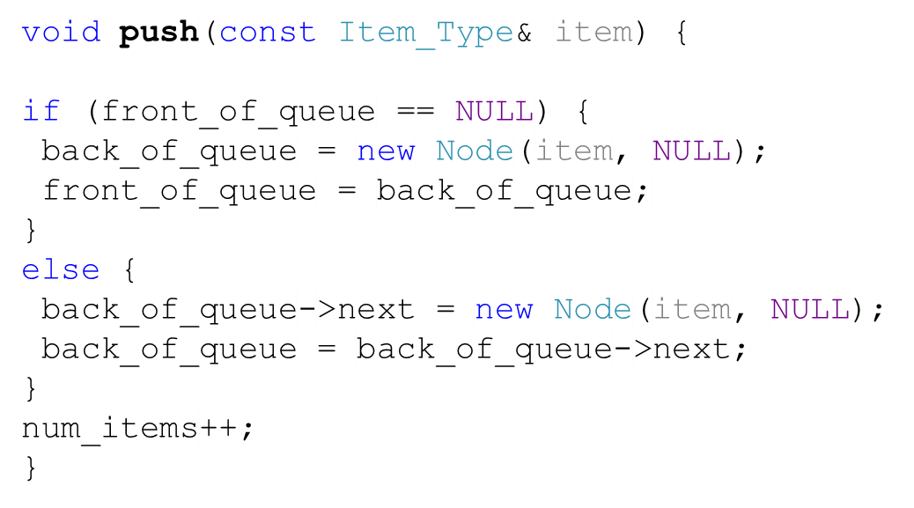
Implementing a Queue using a Linked List (1)
Node
Node
Node
Node
Next=
Data=“Tom”
Next=
Data=“John”
Next= NULL
Data=“Harry”
Next= NULL
Data=“item”
queue
front_of_queue=
back_of_queue=
num_items= 3
4

Slide 16
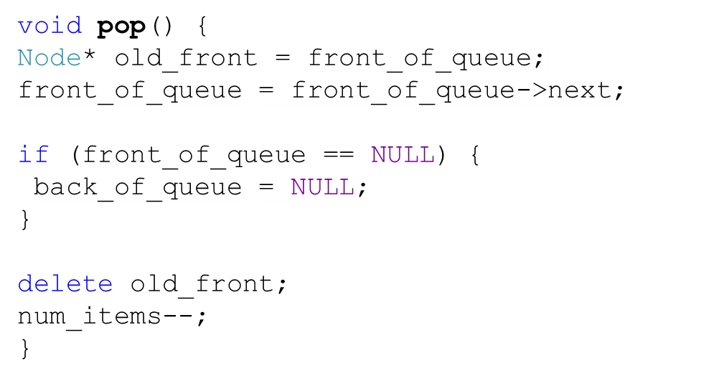
Implementing a Queue using a Linked List (2)
DNode
DNode
DNode
DNode
Next=
Data=“Tom”
Next=
Data=“John”
Next= NULL
Data=“Harry”
Next= NULL
Data=“item”
queue
The performance is O(1) for pop and push.
front_of_queue=
back_of_queue=
num_items= 4
3

Slide 17
Implementing a Queue using an array
The implementation of the queue using a list is rather space inefficient since we need pointers to next.
We can insert an element at the end of the array to implement push.
However, the cost of implementing pop would be O(n) because of the shifting.
front
front
front
Solution? circular array
[0] [1] [2] [3] [4] [5]
[0] [1] [2] [3] [4] [5]
X
Y
Z
A
C
Y
A
D
B
X
Y
Z
B
C
D
Z
back
back
back
back
back
back
back
back
back
back
circular array
regular array

Slide 18


Circular-Array-Based-Queue: Example
front_index
0
A
A
F
front_index
1
B
pop();
push(“F”);
2
C
3
D
4
E
4
5
num_items= 5
capacity= 5

Slide 19
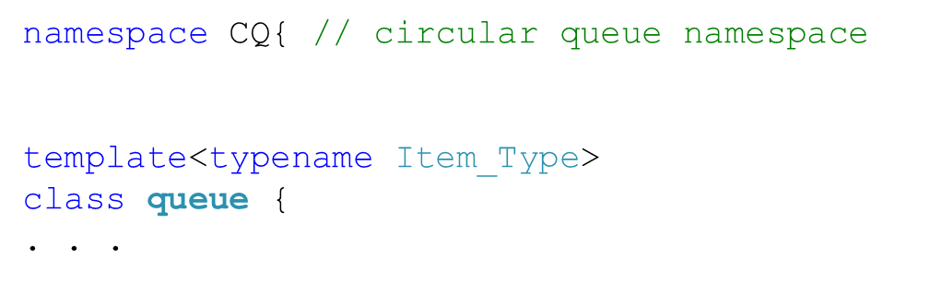
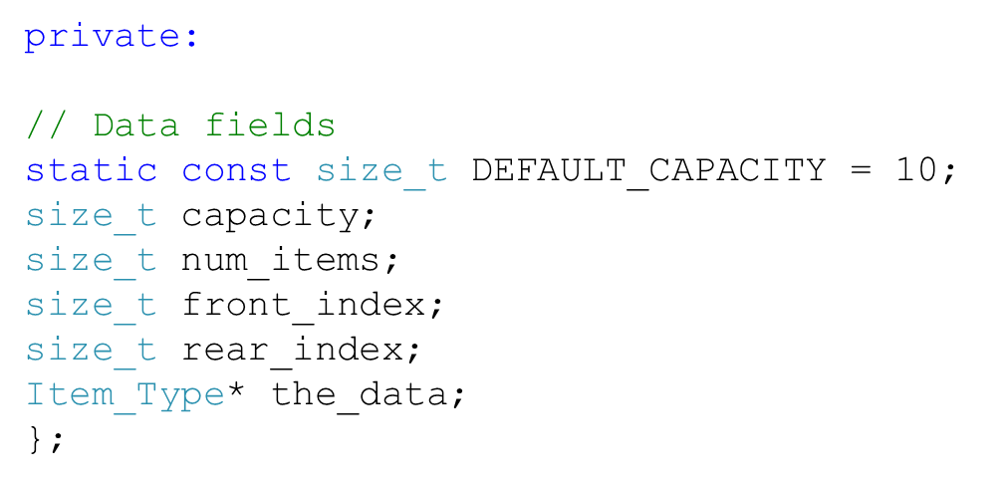
Implementing the Circular Queue

Slide 20
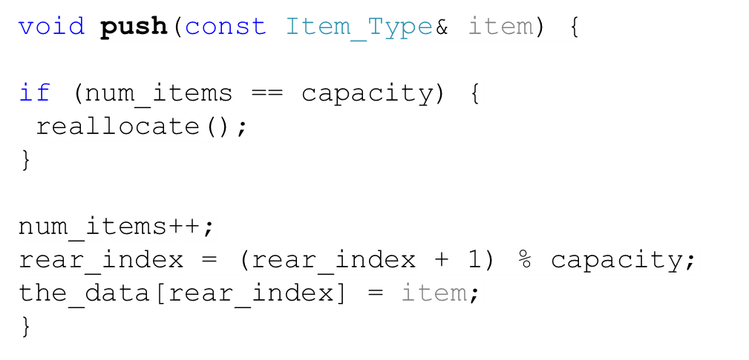
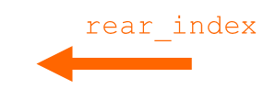
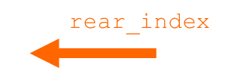



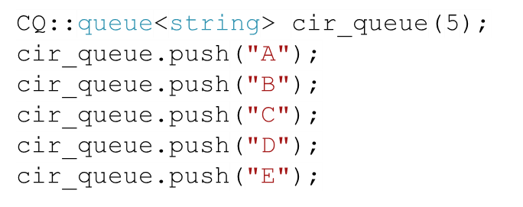
The push Function (1)
front_index
0
A
1
B
2
C
3
D
4
E
5
num_items= 0
2
4
3
1
capacity= 5
front_index = 0
1
3
rear_index = 4
2
4
0

Slide 21
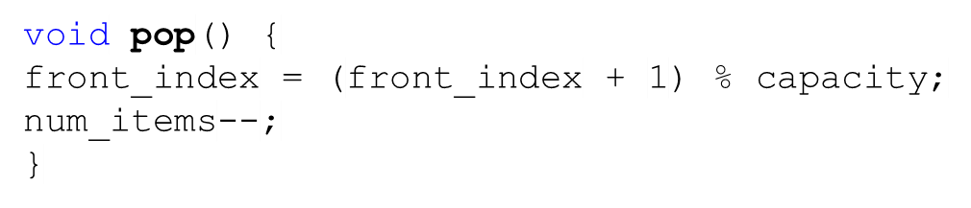

The pop Function
front_index
0
A
A
front_index
1
B
2
C
3
D
4
E
4
5
num_items= 0
2
4
3
1
capacity= 5
front_index = 0
1
1
3
rear_index = 4
2
4
0

Slide 22
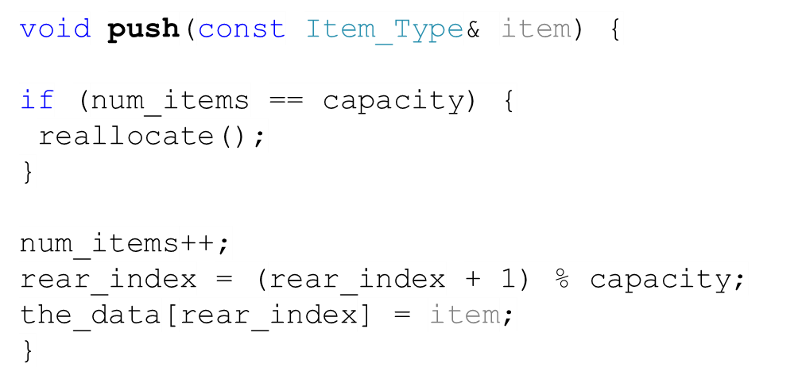



The push Function (2)
0
F
A
A
front_index
1
B
2
C
3
D
4
E
5
4
5
num_items= 0
2
4
3
1
capacity= 5
front_index = 0
1
0
1
3
rear_index = 4
2
4
0

Slide 23




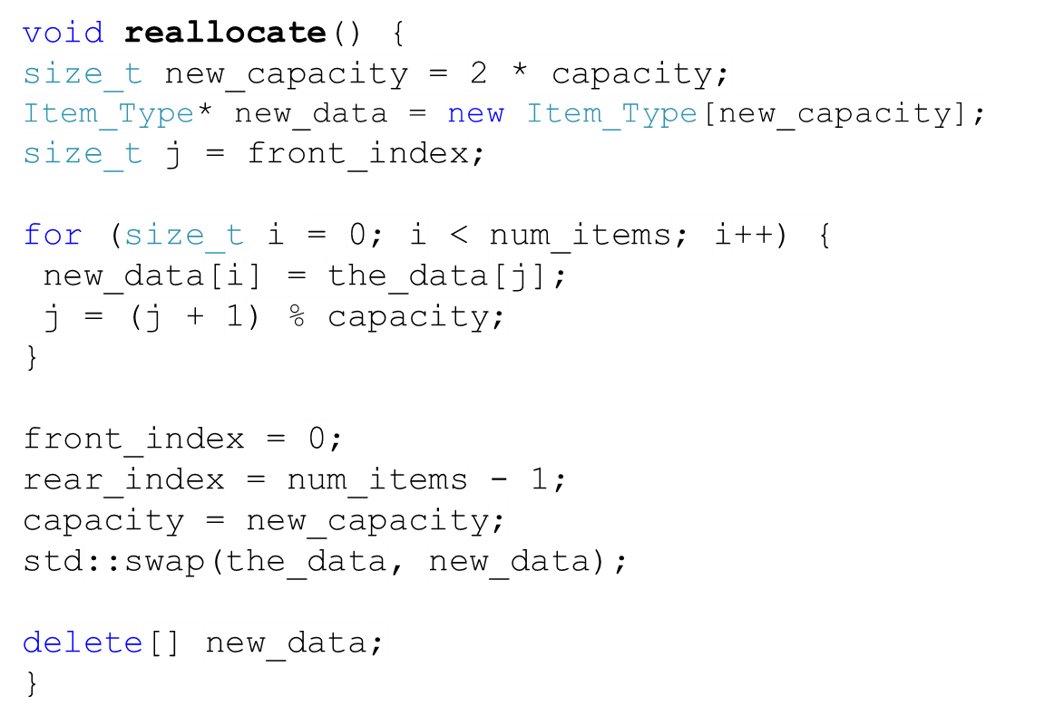


The reallocate Function
0
B
0
F
1
C
1
B
2
D
2
C
3
E
3
D
4
F
4
E
5
6
7
8
9

Slide 24


The push Function (3)
front_index
0
B
1
C
2
D
3
E
rear_index
4
F
rear_index
5
G
6
5
6
4
5
num_items= 0
2
4
3
1
7
capacity= 10
8
9
front_index = 0
0
4
1
3
rear_index = 4
2
4
0
5

Slide 25
Task
We would like to implement a circular-array-based priority queue that pops the item with the highest value rather than the item was inserted first. Your task is to implement the push function of the queue.
So for instance, if we have a priority queue pri_1 (that stores integers), and we push numbers onto it, and then we access the front element, the front element will be the highest number in value (12 in our example).
priority_queue<int> pri_1
pri_1.push(-1);
pri_1.push(-10);
pri_1.push(5);
pri_1.push(12);
front
12
5
-1
back
-10

Slide 26
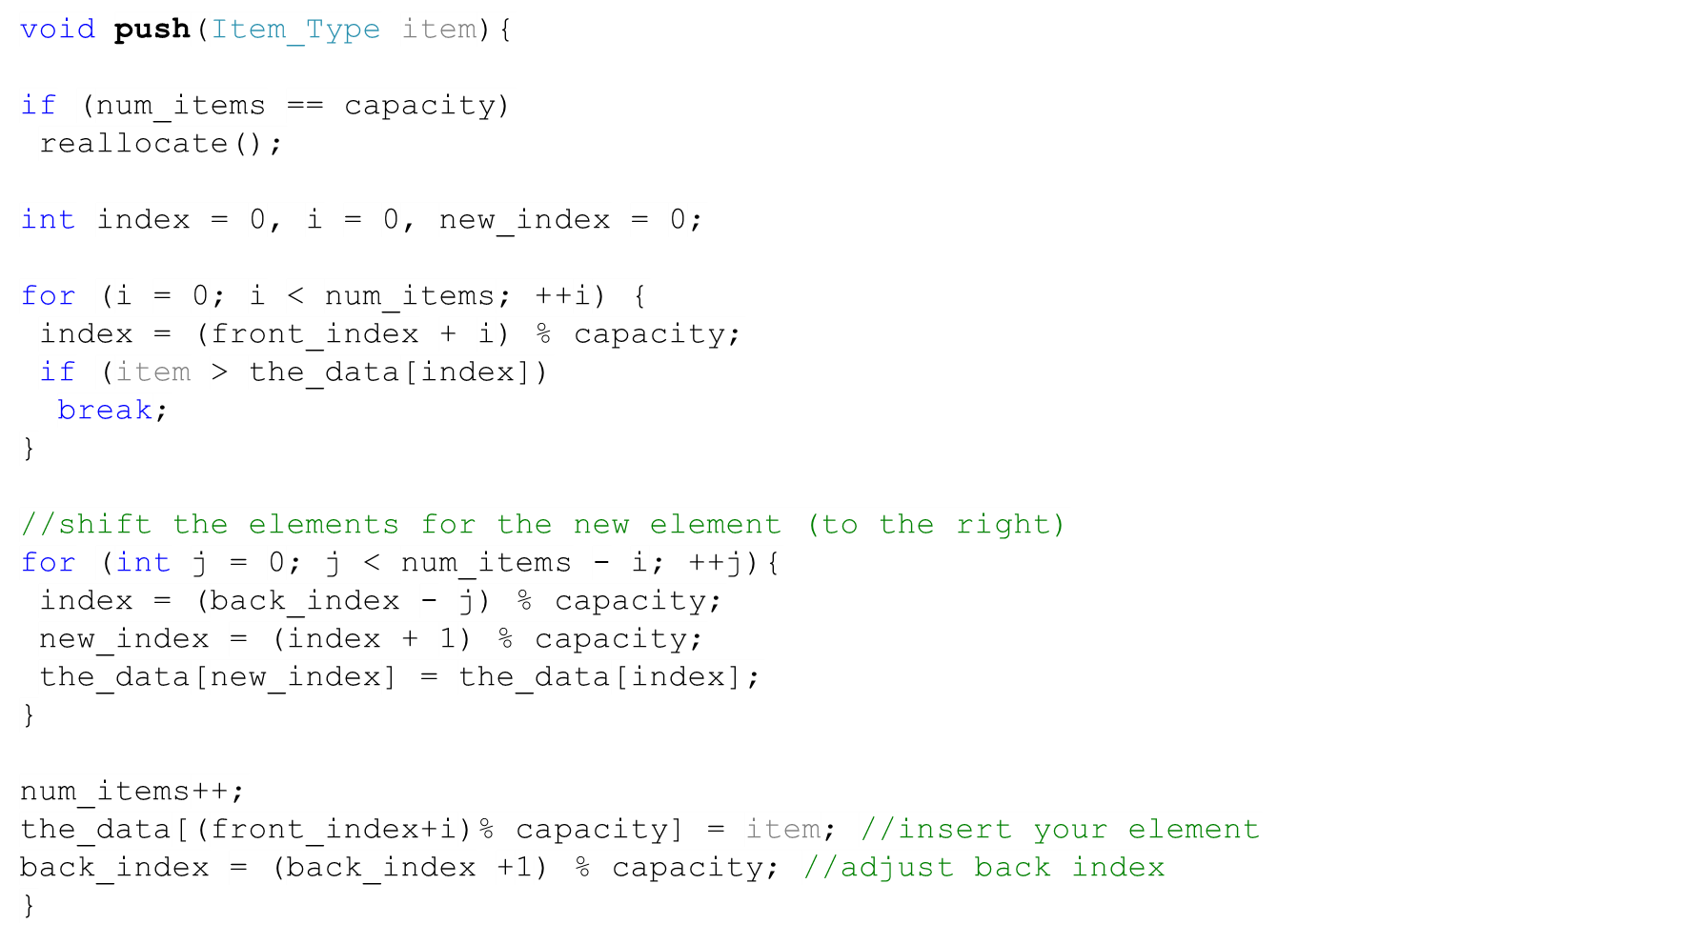
Solution
front
12
back
2
5
-1
front
20
back
-10
10
8

Slide 27
Dequeues
A dequeue (double-ended queue) is a data structure that combines the features of a stack and a queue.
With a dequeue, you can insert, access, and remove items at either end.
The C++ dequeue takes this further, it is considered a sequence. Hence, it supports random-access iterators.

Slide 28



Some Member Functions of the dequeue class
Member Function | Behavior
 | Adds a copy of item to the end of the dequeue
 | Inserts a copy of item as the first element of the dequeue
 | Removes the first item from the dequeue.
 | Removes the last item from the dequeue.
 | Returns a reference to the element at position i that can be used as a target of an assignment.

Slide 29
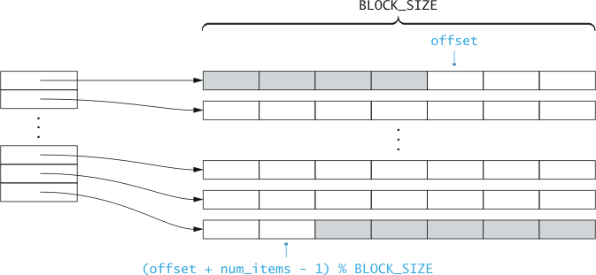
Implementing Dequeues
Each item in the circular array points to a fixed size, dynamically allocated array that contains the data.
  The advantage of this implementation is that when reallocation is required, only the pointers need to be copied into the new circular array.
Notes:
Compare the difference between 1D and 2D, and why this is better

Slide 30
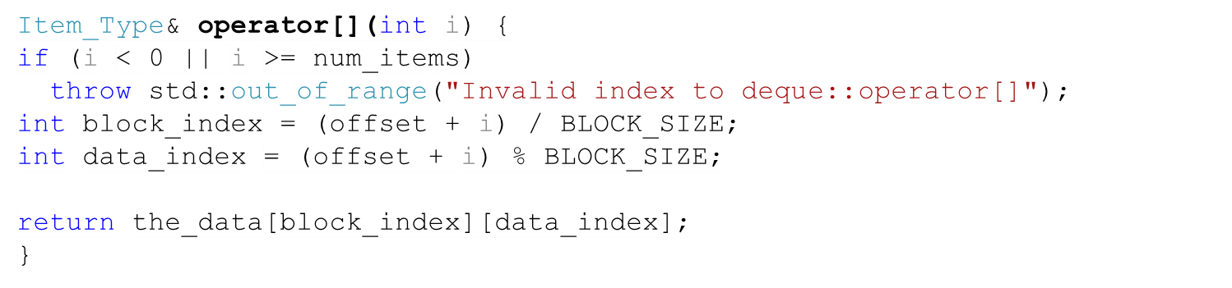



The Index Operator
BLOCK_SIZE
offset
the_data
0 | 1 | 2 | 3 | 4
 |  | 0 | 1 | 2
3 | 4 | 5 | 6 | 7
8 | 9 | 10 | 11 | 12
13 | 14 | 15 | 16 | 17
18
0
1
2
3
4
( offset + num_items – 1 ) % BLOCK_SIZE

Slide 31
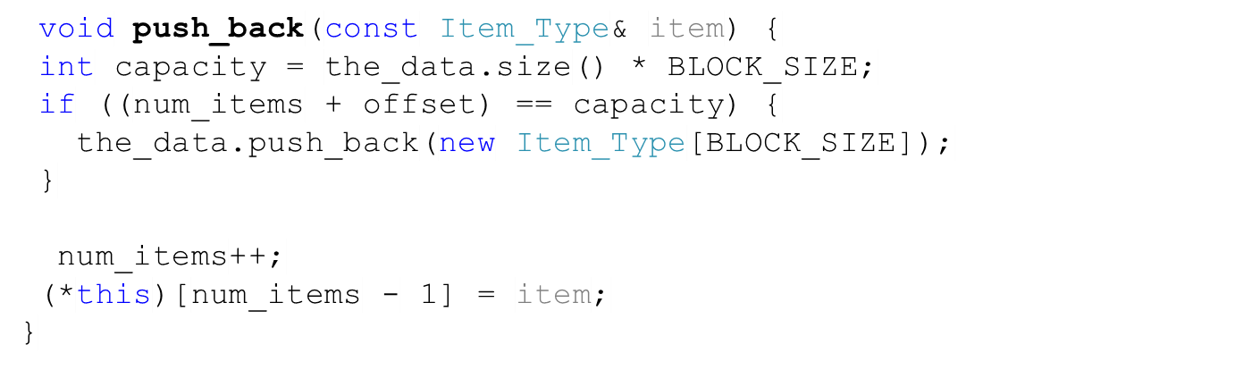



The push_back Function
BLOCK_SIZE
offset
the_data
0 | 1 | 2 | 3 | 4
 |  | 0 | 1 | 2
3 | 4 | 5 | 6 | 7
8 | 9 | 10 | 11 | 12
13 | 14 | 15 | 16 | 17
0
1
2
3
4
4
18
used
unused

Slide 32
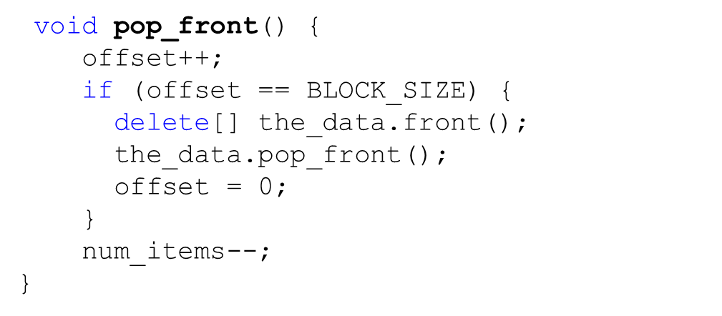

The pop_front Function
BLOCK_SIZE
the_data
offset
0 | 1 | 2 | 3 | 4
3 | 4 | 5 | 6 | 7
8 | 9 | 10 | 11 | 12
13 | 14 | 15 | 16 | 17
0
0
1
2
3
4
 |  |  |  | 2
offset
4
18
used
unused

Slide 33
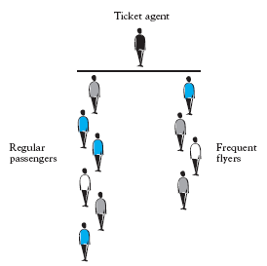
Simulating Waiting Lines Using Queues
An airline company would like to have two separate waiting lines: one for regular customers and one for frequent flyers.
The company would like to determine the average waiting time for both types of passengers using various strategies.
A “democratic strategy”: regular and frequent passengers take turns, or serving the customer that has been waiting the longest.
An “elitist strategy”: serve any frequent flyer waiting in line before serving the regular passengers.

Slide 34
Parameters
frequent_flyer_max //num of max frequent flyers to serve before a regular passenger
arrival_rate //for regular and frequent passengers
max_processing_time //max time to process a service

Slide 35
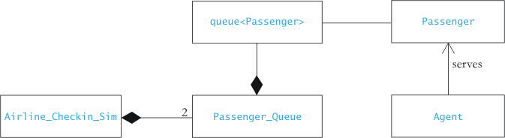
Design
1 *
1
*
1
1
1

Slide 36
Detailed Class Diagram
queue<Passenger>
1
Passenger
+ push()
+ pop()
+ front()
+ size()
+ empty()
*
passenger_id
processing_time
arrival_time
max_processing_time
Airline_Checkin_Sim
- the_queue
frequent_flyer_max
max_processing_time
total_time
show_all
clock
time_done
frequent_flyers_since_RP
+ get_arrival_time()
+ get_processing_time()
+ set_max_processing_time()
1
1
- regular_passenger_queue
Passenger_Queue
num_served
total_wait
queue_name
arrival_rate
- frequent_flyer_queue
+ enter_data()
+ run_simulation()
+ start_serve()
+ show_stats()
1
+ get_num_served()
+ get_total_wait()
+ check_new_arrival()
+ update()

Slide 37
Example Design
We will maintain a simulated clock
  Counts in integer “ticks”, from 0
At each tick, one or more events can happen:
  Frequent flyer (FF) passenger arrives in line
  Regular (R) passenger arrives in line
  Agent finishes, then serves next FF passenger
  Agent finishes, then serves next R passenger
  Agent is idle (both lines empty)

Slide 38
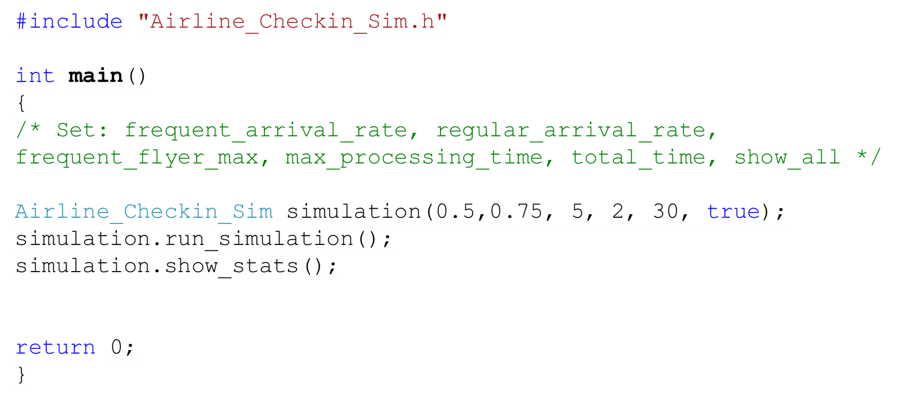
Main

Slide 39
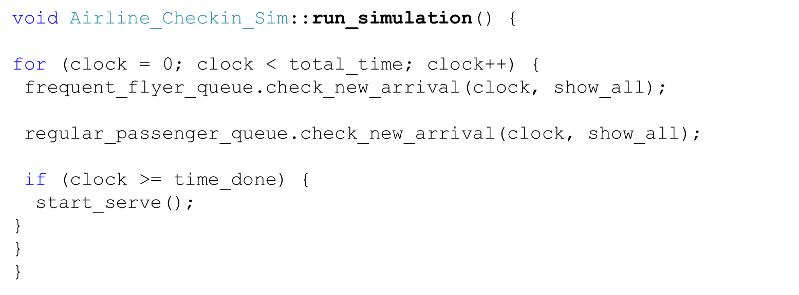
run_simulation

Slide 40
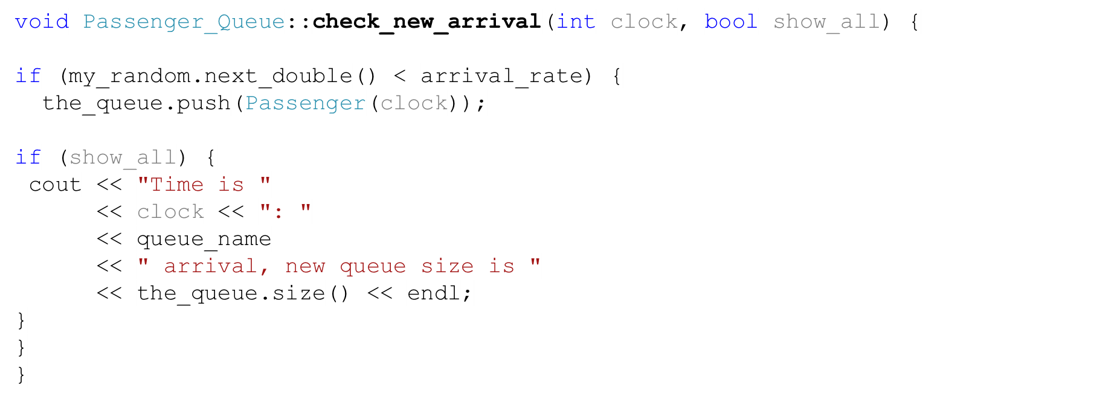
Passenger_Queue::check_new_arrival

Slide 41
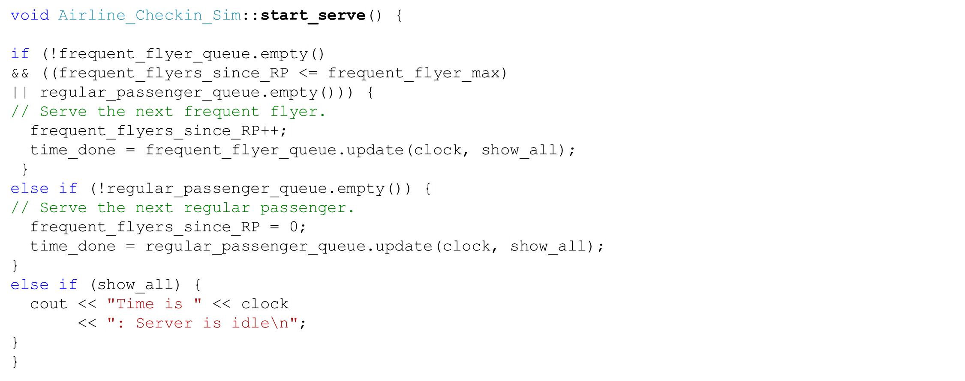
start_serve

Slide 42
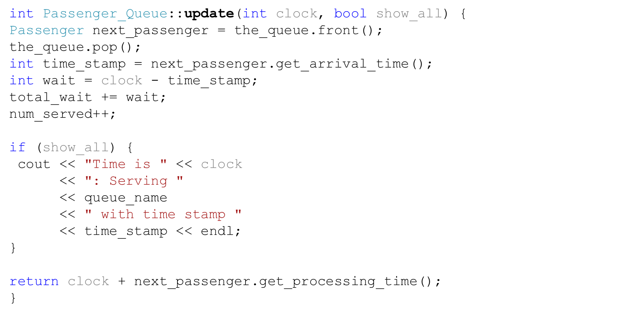
update

